Slide 1
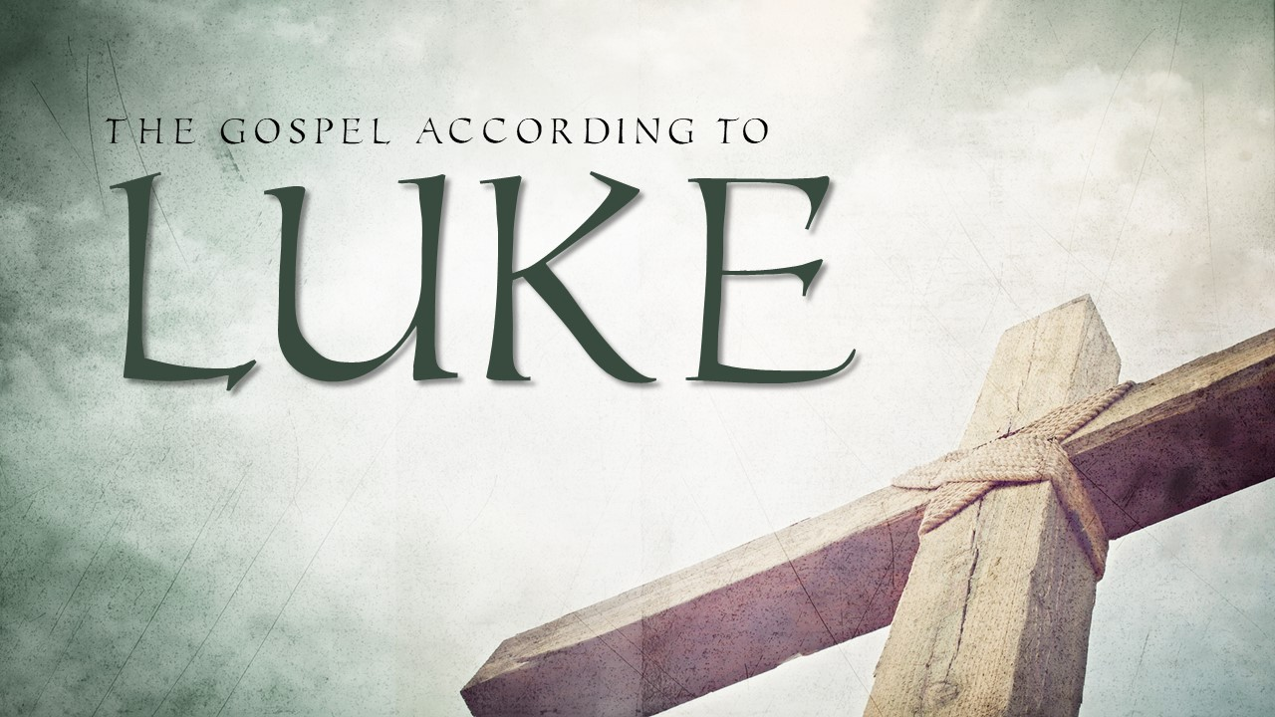

Slide 2
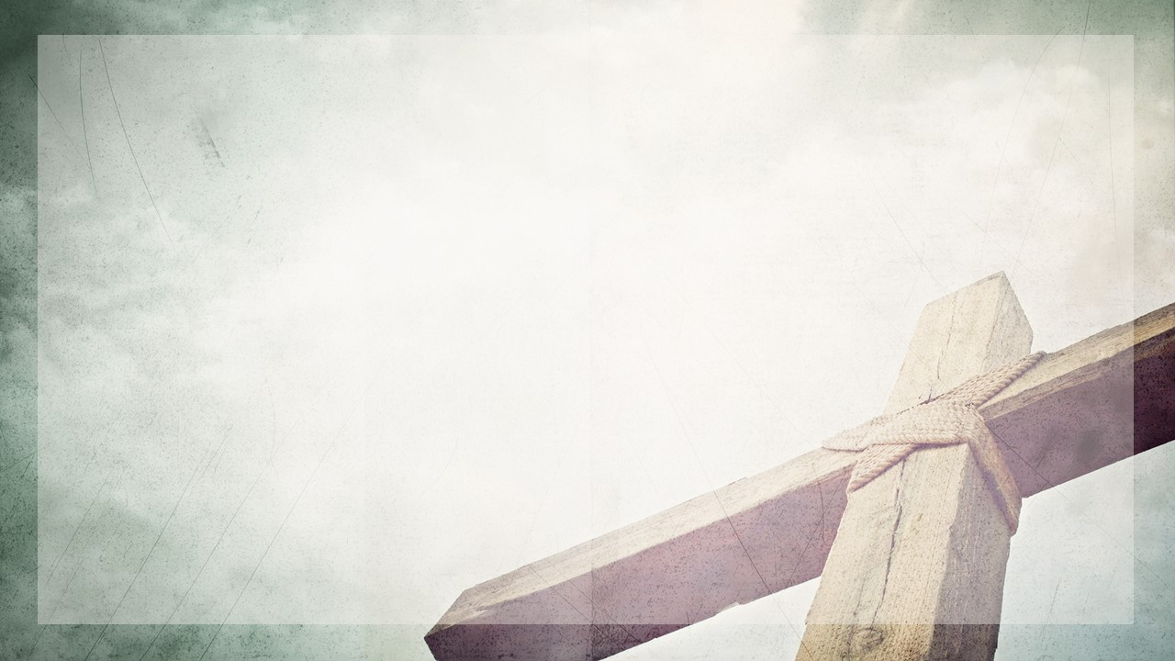
We must choose to trust God through every seasons of life.
Notice three seasons in Luke 1:5-25.

Slide 3
3 Seasons of Life Where We Must Trust God
The Season of Silence. V.5-17

Slide 4
(13) But the angel said unto him, Fear not, Zacharias: for thy prayer is heard; and thy wife Elisabeth shall bear thee a son, and thou shalt call his name John. (14) And thou shalt have joy and gladness; and many shall rejoice at his birth.

Slide 5
(15) For he shall be great in the sight of the Lord, and shall drink neither wine nor strong drink; and he shall be filled with the Holy Ghost, even from his mother's womb.

Slide 6
(17) And he shall go before him in the spirit and power of Elias

Slide 7
And they answered him, He was an hairy man, and girt with a girdle of leather about his loins. And he said, It is Elijah the Tishbite." Both Elijah and John lived in the wilderness. Both Elijah and John spoke boldly to people in power and were tormented by kings and their queens. Both had moments of doubt about their ministry and were affirmed by God in what He was doing beyond them.
2 Kings 1:8

Slide 8
(16) And many of the children of Israel shall he turn to the Lord their God

Slide 9
(5) Behold, I will send you Elijah the prophet before the coming of the great and dreadful day of the LORD: (6) And he shall turn the heart of the fathers to the children, and the heart of the children to their fathers, lest I come and smite the earth with a curse. Malachi 4:5-6

Slide 10
(17) And he shall go before him in the spirit and power of Elias, to turn the hearts of the fathers to the children, and the disobedient to the wisdom of the just; to make ready a people prepared for the Lord.

Slide 11
And a certain Jew named Apollos, born at Alexandria, an eloquent man, and mighty in the scriptures, came to Ephesus. (25) This man was instructed in the way of the Lord; and being fervent in the spirit, he spake and taught diligently the things of the Lord, knowing only the baptism of John.

Slide 12
(26) And he began to speak boldly in the synagogue: whom when Aquila and Priscilla had heard, they took him unto them, and expounded unto him the way of God more perfectly.

Slide 13
(27) And when he was disposed to pass into Achaia, the brethren wrote, exhorting the disciples to receive him: who, when he was come, helped them much which had believed through grace: (28) For he mightily convinced the Jews, and that publickly, shewing by the scriptures that Jesus was Christ.
Acts 18:24-28

Slide 14
3 Seasons of Life Where We Must Trust God
The Season of Silence. V.5-17
The Season of Doubt. V.18-20

Slide 15
(18) And Zacharias said unto the angel, Whereby shall I know this? for I am an old man, and my wife well stricken in years.

Slide 16
Then Abraham fell upon his face, and laughed, and said in his heart, Shall a child be born unto him that is an hundred years old? and shall Sarah, that is ninety years old, bear?
(Genesis 17:17)

Slide 17
(19) And the angel answering said unto him, I am Gabriel, that stand in the presence of God; and am sent to speak unto thee, and to shew thee these glad tidings.

Slide 18
(20) And, behold, thou shalt be dumb, and not able to speak, until the day that these things shall be performed, because thou believest not my words, which shall be fulfilled in their season.

Slide 19
3 Seasons of Life Where We Must Trust God
The Season of Silence. V.5-17
The Season of Doubt. V.18-20
The Season of Provision. V.21-25

Slide 20
And the people waited for Zacharias, and marvelled that he tarried so long in the temple.

Slide 21
(22) And when he came out, he could not speak unto them: and they perceived that he had seen a vision in the temple: for he beckoned unto them, and remained speechless.

Slide 22
(24) And after those days his wife Elisabeth conceived….

Slide 23
(24) And after those days his wife Elisabeth conceived….

Slide 24
…and hid herself five months, saying, (25) Thus hath the Lord dealt with me in the days wherein he looked on me, to take away my reproach among men.

Slide 25
But Christ being come an high priest of good things to come, by a greater and more perfect tabernacle, not made with hands, that is to say, not of this building; (12) Neither by the blood of goats and calves, but by his own blood he entered in once into the holy place, having obtained eternal redemption for us.

Slide 26
(13) For if the blood of bulls and of goats, and the ashes of an heifer sprinkling the unclean, sanctifieth to the purifying of the flesh: (14) How much more shall the blood of Christ, who through the eternal Spirit offered himself without spot to God, purge your conscience from dead works to serve the living God? Hebrews 9:11-14

Slide 27
3 Seasons of Life Where We Must Trust God
The Season of Silence. V.5-17
The Season of Doubt. V.18-20
The Season of Provision. V.21-25

