Slide 1

Great Expectations
Planting Seeds for Sunday School Growth

Slide 2
The mission of the local church is the Great Commission.

Slide 3
And Jesus came and spake unto them, saying, All power is given unto me in heaven and in earth. (19) Go ye therefore, and teach all nations, baptizing them in the name of the Father, and of the Son, and of the Holy Ghost: (20) Teaching them to observe all things whatsoever I have commanded you: and, lo, I am with you alway, even unto the end of the world. Amen
Matthew 28:18-20

Slide 4
The largest organization in the church is the Sunday School.
If the Sunday School is not a great commission organization, then we will have a difficult time being a great commission church.

Slide 5
And Jesus went about all Galilee, teaching in their synagogues, and preaching the gospel of the kingdom, and healing all manner of sickness and all manner of disease among the people.
Matthew 4:23

Slide 6
Our church, and our Sunday School has three tasks.
Reach people.
Teach people.
Minister to people.

Slide 7
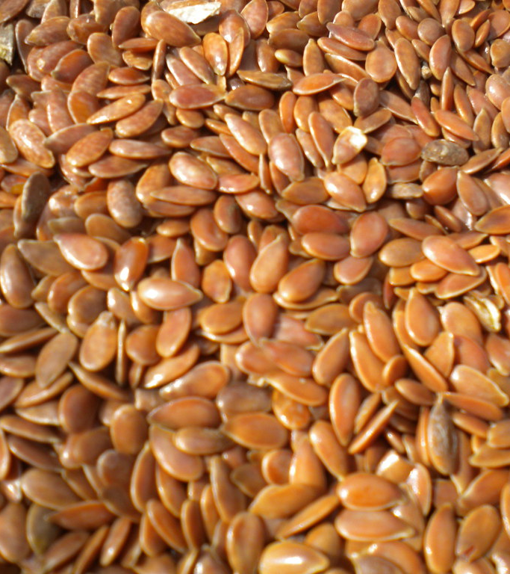
Great Expectations
This Photo by Unknown Author is licensed under CC BY

Slide 8

Great Expectations
This Photo by Unknown Author is licensed under CC BY-SA

Slide 9
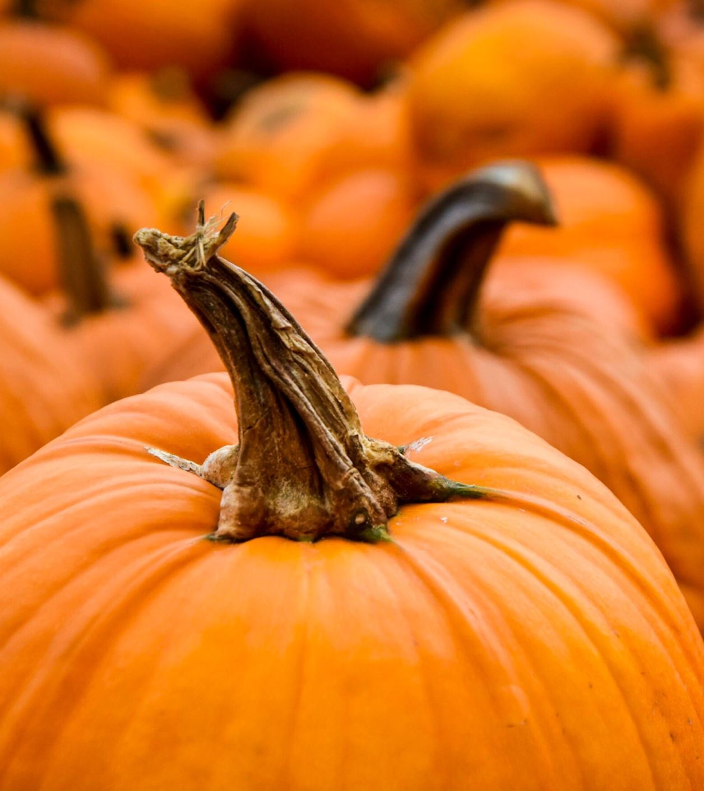
Great Expectations

Slide 10
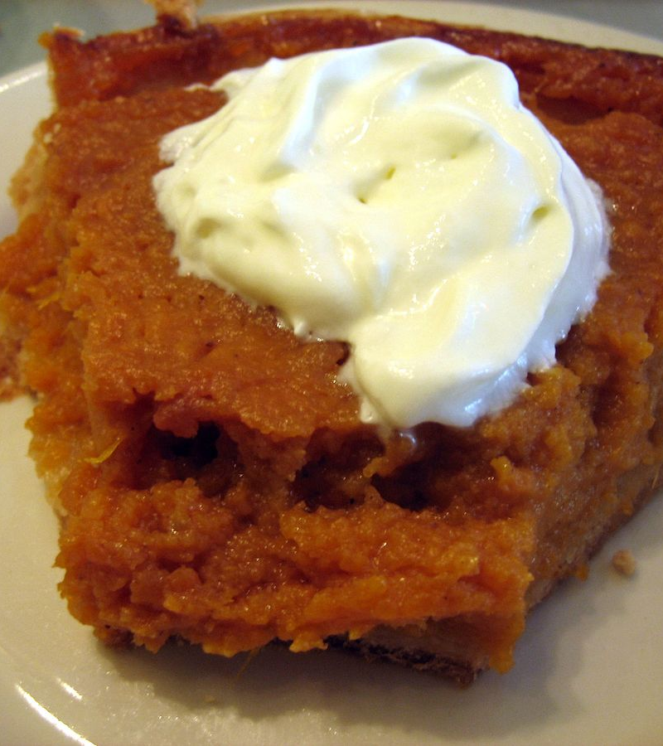
Great Expectations
This Photo by Unknown Author is licensed under CC BY-SA

Slide 11
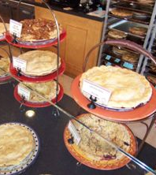
Great Expectations
This Photo by Unknown Author is licensed under CC BY-SA

Slide 12
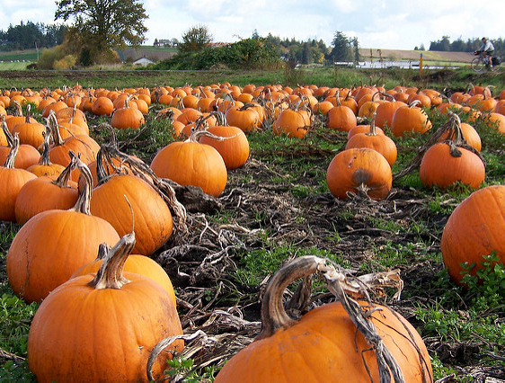
Great Expectations
This Photo by Unknown Author is licensed under CC BY

Slide 13
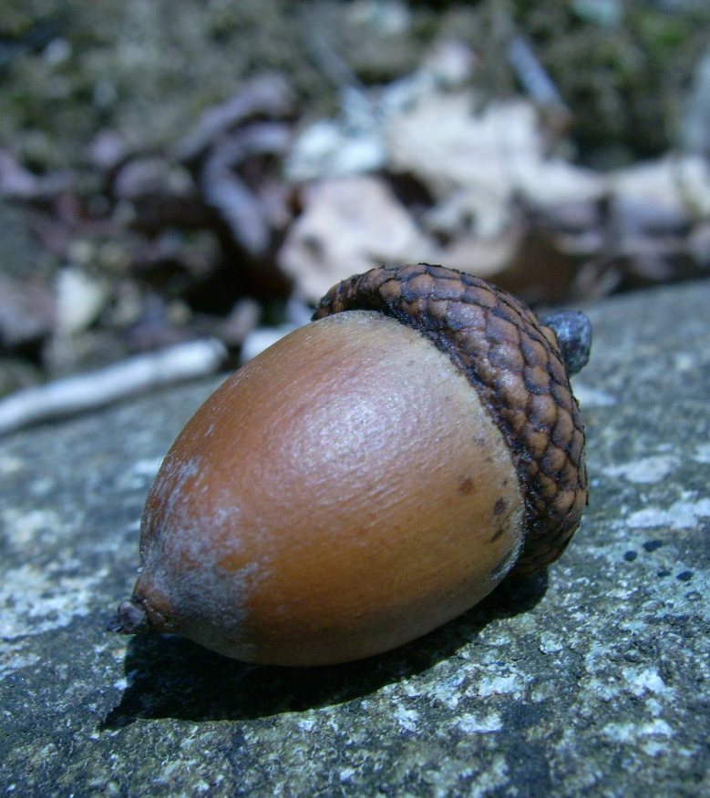
Great Expectations
This Photo by Unknown Author is licensed under CC BY-SA

Slide 14
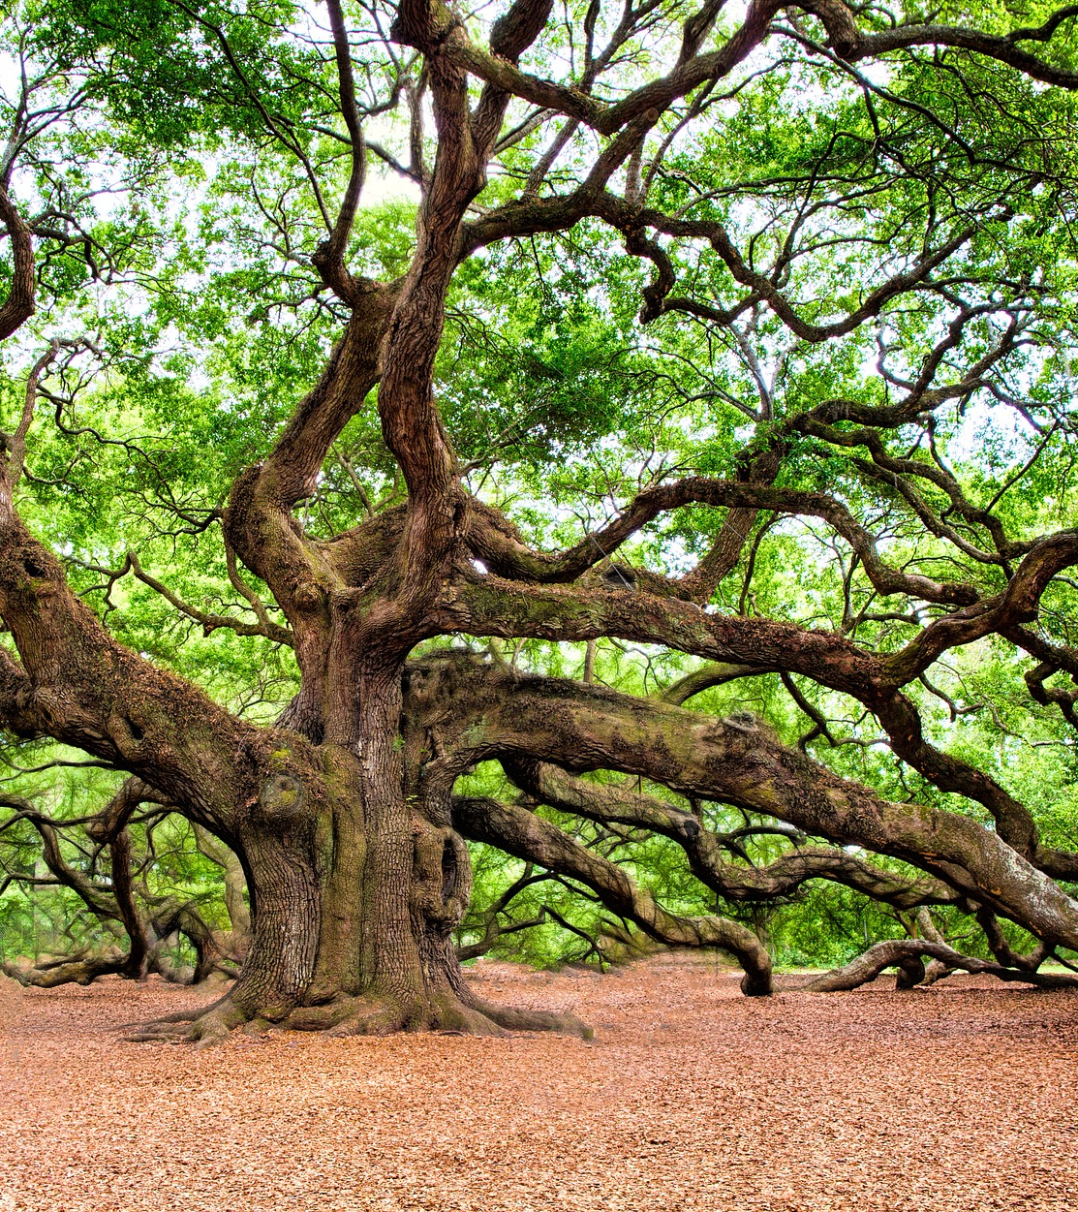
Great Expectations
This Photo by Unknown Author is licensed under CC BY-SA

Slide 15

Great Expectations
This Photo by Unknown Author is licensed under CC BY-NC-ND

Slide 16

Great Expectations

Slide 17

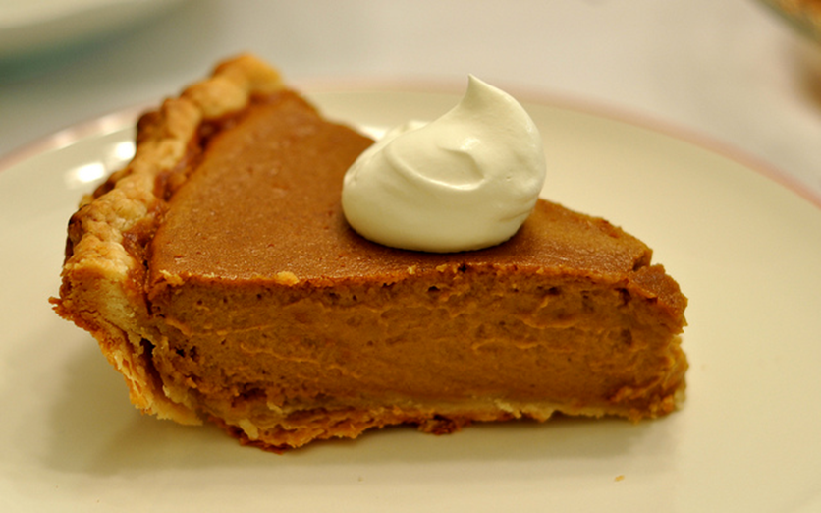


How does this happen?

Slide 18
How does this happen?
Stewardship!

Slide 19
The farmer doesn’t cause the plant to grow. God has created the seed to sprout and to grow. The farmer just stewards the conditions that lead to the growth of the plant.

Slide 20
And he said, So is the kingdom of God, as if a man should cast seed into the ground; And should sleep, and rise night and day, and the seed should spring and grow up, he knoweth not how. For the earth bringeth forth fruit of herself; first the blade, then the ear, after that the full corn in the ear. But when the fruit is brought forth, immediately he putteth in the sickle, because the harvest is come.
Mark 4:26-29

Slide 21
If there was no expectation of growth and harvest, then there would be no stewardship.

Slide 22
But we do have a stewardship!
“And he said unto them, Take heed what ye hear: with what measure ye mete, it shall be measured to you: and unto you that hear shall more be given. For he that hath, to him shall be given: and he that hath not, from him shall be taken even that which he hath.”
Mark 4:24-25

Slide 23
There is an incredible link between expectations and growth.

Slide 24
What do you see?

Slide 25
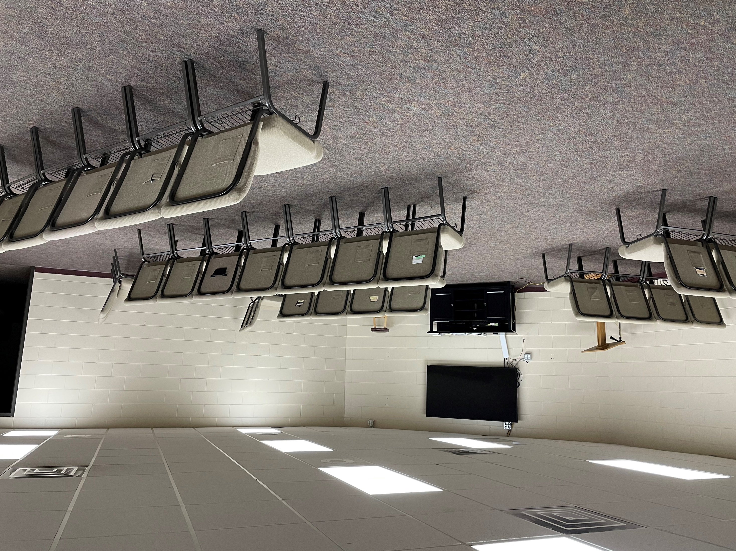

Slide 26
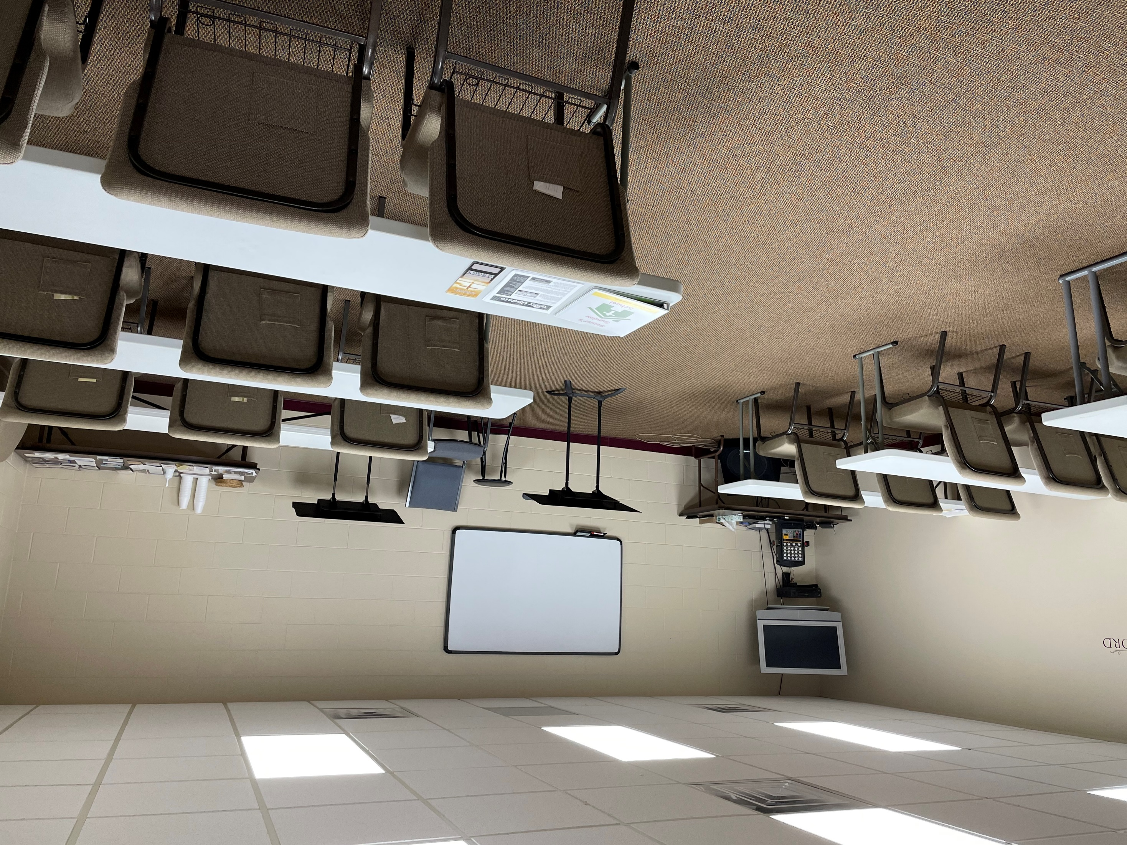

Slide 27
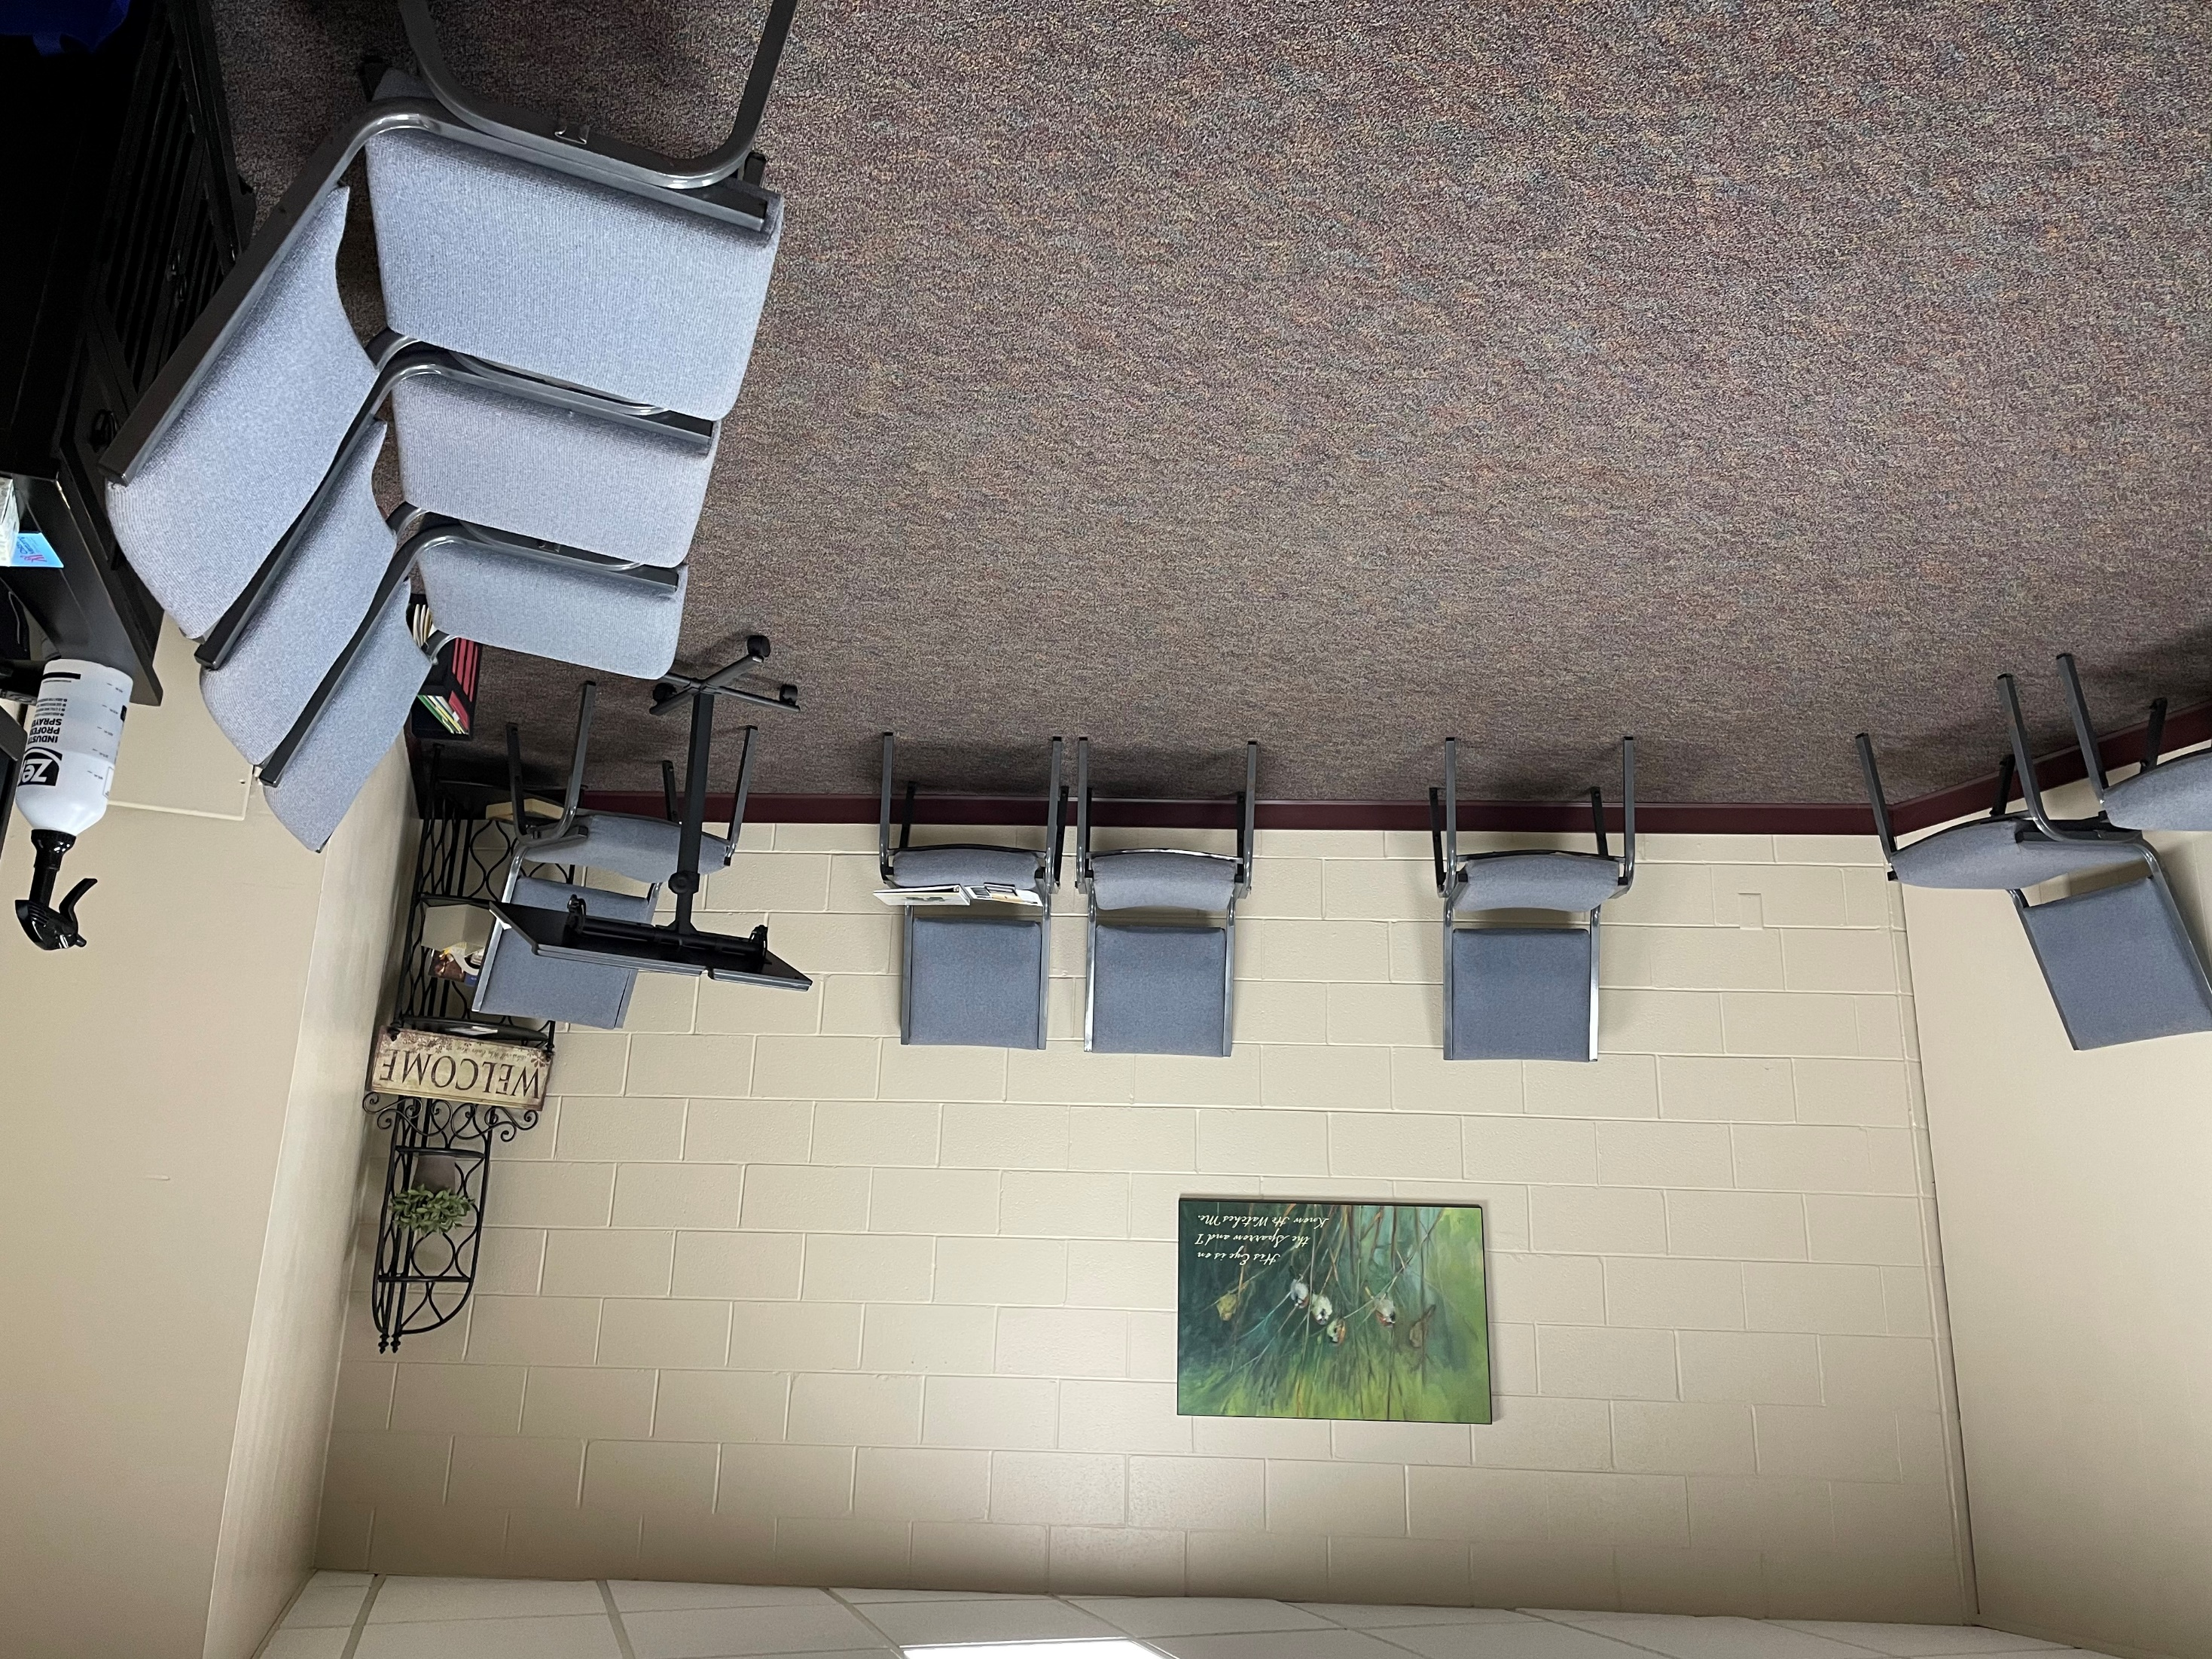

Slide 28
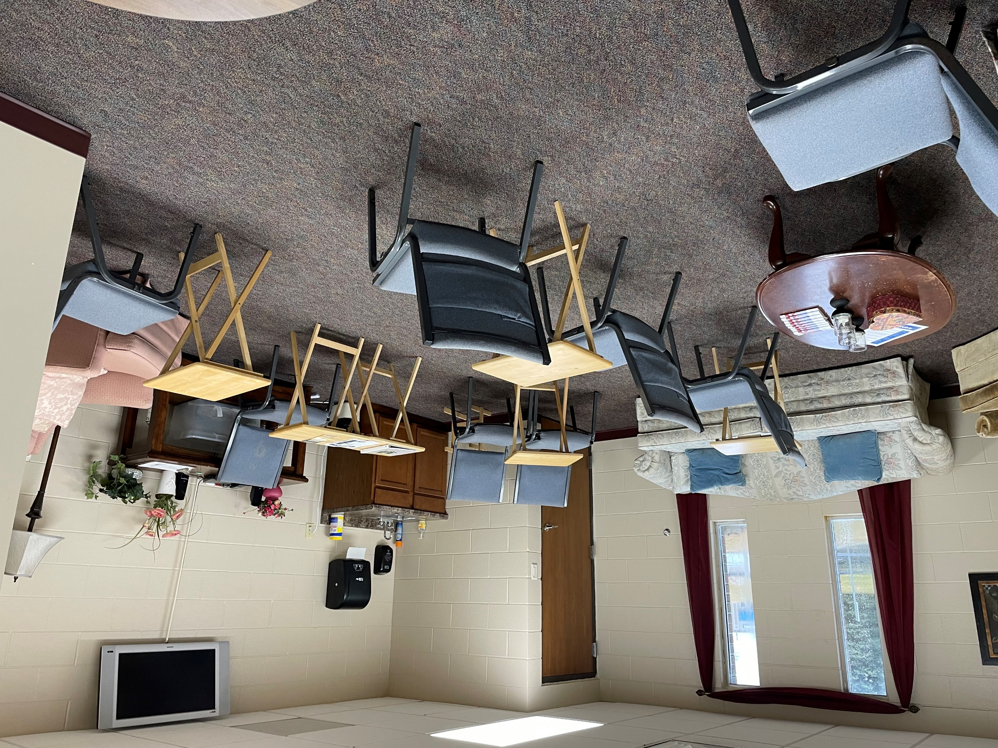

Slide 29
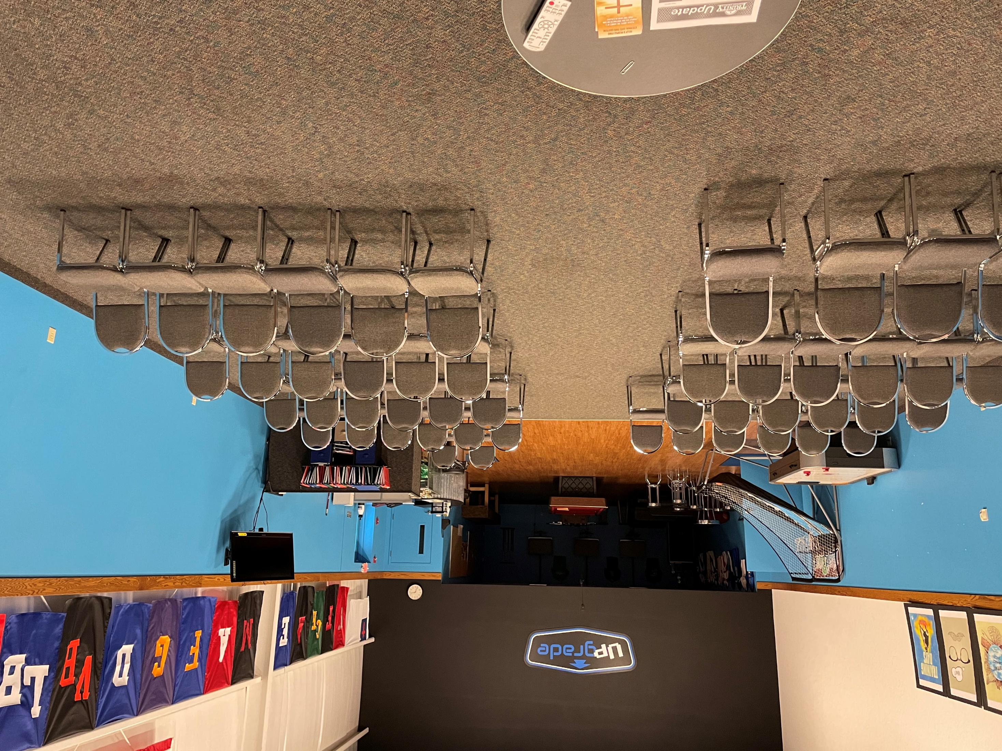

Slide 30
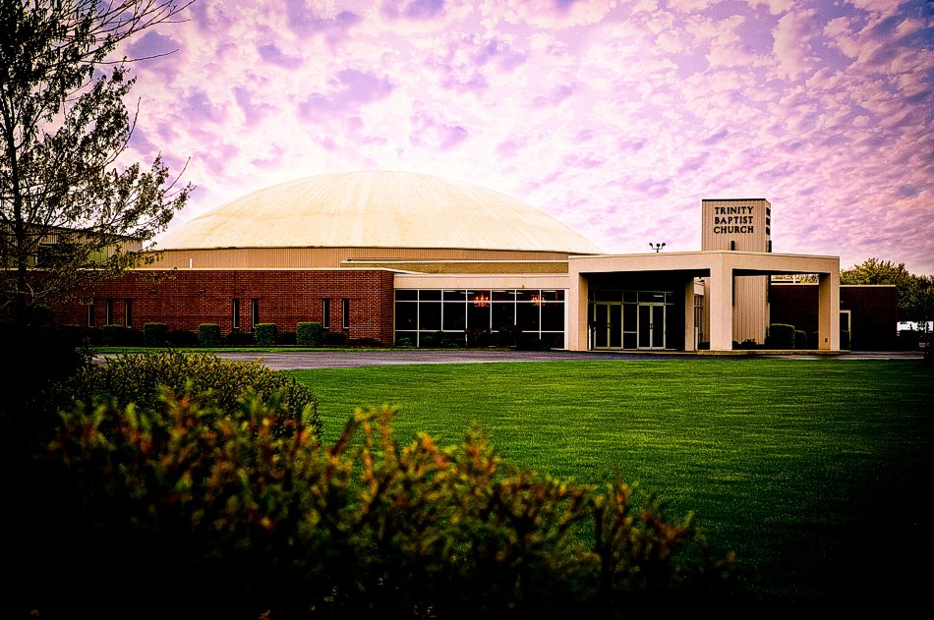

Slide 31
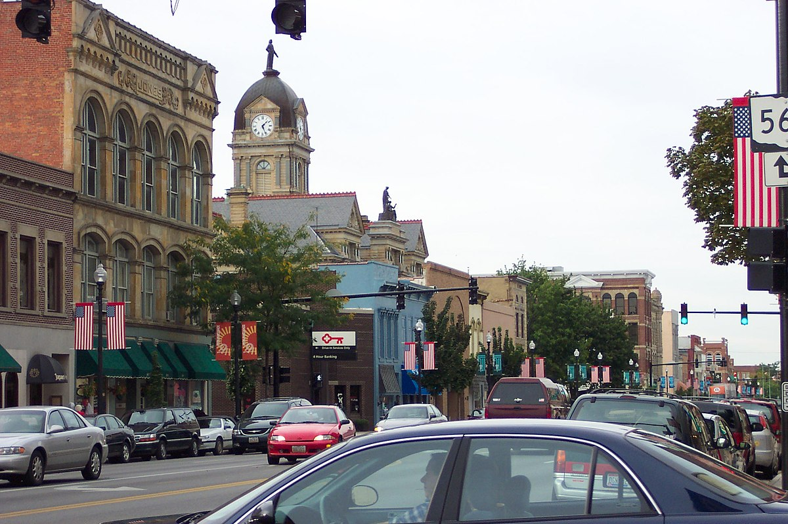

Slide 32
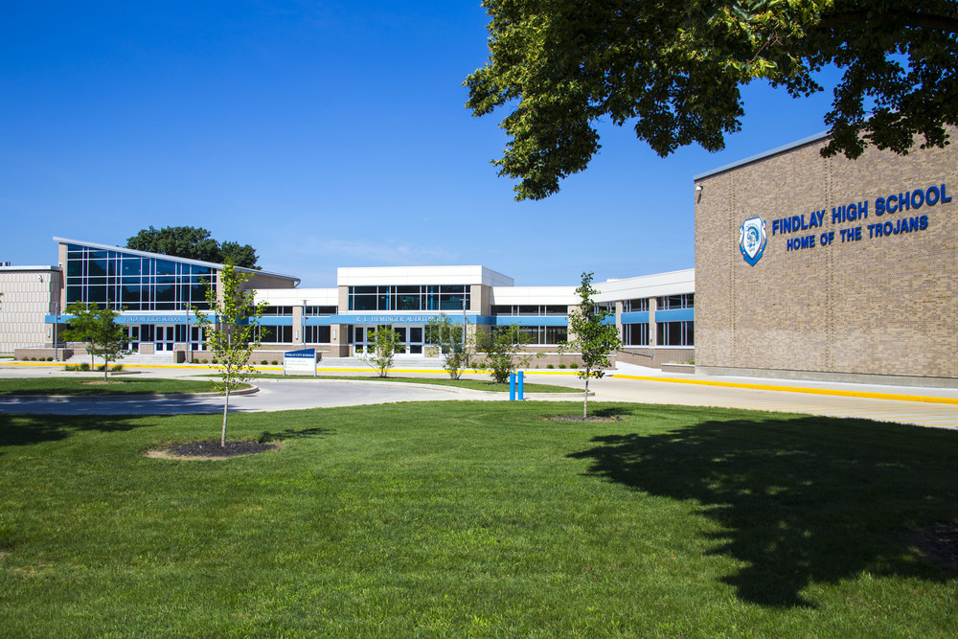

Slide 33
What do you expect God to do through your Sunday School class?

Slide 34
If what gets us from seed to harvest in the plant world is a stewardship that is driven by expectations, is that principle transferable to our Sunday School classes?
Absolutely!

Slide 35
5 Minute Discussion:
1- What are some great expectations that Sunday School Leaders should have …of themselves?
…of their class?
2-What are the great expectations that your Sunday School class should have in order to see both spiritual and numerical growth?

Slide 36
Expectation #1:
A Great Expectations Class expects new people and a great bible study experience every week.

Slide 37
An open group expects new people every week.

Slide 38
If our Sunday School classes are going to be open groups that means:
No throwaway Sundays.

Slide 39
If our Sunday School classes are going to be open groups that means:
No throwaway Sundays.
The Psychology of Invitation

Slide 40
If our Sunday School classes are going to be open groups that means:
No throwaway Sundays.
The Psychology of Invitation
Anyone is welcome any week.

Slide 41
If our Sunday School classes are going to be open groups that means:
No throwaway Sundays.
The Psychology of Invitation
Anyone is welcome any week.
Leaders and workers arrive early.

Slide 42
If our Sunday School classes are going to be open groups that means:
No throwaway Sundays.
The Psychology of Invitation
Anyone is welcome any week.
Leaders and workers arrive early.
The room communicates that we expect guests like you.

Slide 43
If our Sunday School classes are going to be open groups that means:
No throwaway Sundays.
The Psychology of Invitation
Anyone is welcome any week.
Leaders and workers arrive early.
The room communicates that we expect guests like you.
A great Bible Study experience every week.

Slide 44
Discussion Questions
Does my class and its leaders expect new people every week?
Is there anything that we’re doing that may make our class closed? (No expectation of new people and not very open to new people when they come).
What are 3 things I can do to increase the openness of my class on Sunday morning to new people?

Slide 45
Great Expectations
Planting Seeds for Sunday School Growth

Slide 46
What are the great expectations that your Sunday School class should have in order to see both spiritual and numerical growth?

Slide 47
Expectation #1:
A Great Expectations Class expects new people and a great bible study experience every week.

Slide 48
Expectation #2
A Great Expectations Class expects people to say yes!

Slide 49
Expectation #2
A Great Expectations Class expects people to say yes!
“Yes” to an invitation to attend.
“Yes” to enrollment.

Slide 50
Open enrollment means people can belong before they believe.

Slide 51
They don’t have to believe the Bible. They don’t have to be a Christian. They don’t even have to like God! They just have to say yes to an invitation to enroll as members of the class, to agree to have their names placed on the class ministry list.

Slide 52
We call it a ministry list instead of a class roll because of the commitment each term implies. Being on a class roll implies that a member is committed to attending the class.

Slide 53
Being on a ministry list implies that the class is committed to ministering to the member—whether or not that person attends regularly.

Slide 54
An open group that practices open enrollment says, “We have a stewardship of anyone that will give us permission to minister to them.”

Slide 55
Expectation #2
A Great Expectations Class expects people to say yes!
“Yes” to an invitation to attend.
“Yes” to enrollment.
“Yes” to the total ministry of the class.

Slide 56
Expectation #2
A Great Expectations Class expects people to say yes!
“Yes” to an invitation to attend.
“Yes” to enrollment.
“Yes” to the total ministry of the class.
“Yes” to evangelistic prayer.

Slide 57
Expectation #2
A Great Expectations Class expects people to say yes!
“Yes” to an invitation to attend.
“Yes” to enrollment.
“Yes” to the total ministry of the class.
“Yes” to evangelistic prayer.
“Yes” to leadership meetings.

Slide 58
Expectation #2
A Great Expectations Class expects people to say yes!
“Yes” to an invitation to attend.
“Yes” to enrollment.
“Yes” to the total ministry of the class.
“Yes” to evangelistic prayer.
“Yes” to leadership meetings.
“Yes” to training.

Slide 59
Expectation #2
A Great Expectations Class expects people to say yes!
“Yes” to an invitation to attend.
“Yes” to enrollment.
“Yes” to the total ministry of the class.
“Yes” to evangelistic prayer.
“Yes” to leadership meetings.
“Yes” to training.
“Yes” to planting new classes.

Slide 60
Discussion Questions:
Of all of the expectations to say yes, which one is our class the best at? Where do we need work?

Slide 61
Great Expectations
Planting Seeds for Sunday School Growth

Slide 62
What are the great expectations that your Sunday School class should have in order to see both spiritual and numerical growth?

Slide 63
Expectation #1:
A Great Expectations Class expects new people and a great bible study experience every week.

Slide 64
Expectation #2
A Great Expectations Class expects people to say yes!

Slide 65
Expectation #3-
A Great Expectation Class says expects that weekly ministry both inside and outside of the class will lead to spiritual and numerical growth.

Slide 66
You can help your class to grow numerically and spiritually by recognizing 3 types of people who need to be connected to each week.

Slide 67
You can help your class to grow numerically and spiritually by recognizing 3 types of people who need to be connected to each week.
Guests

Slide 68
Guests
The primary ministry to our guests beyond is a discernment ministry.

Slide 69
Guests: What do we want to know about guests?
Saved?
Baptized?
Member of a Bible Believing Church?
Can we minister to you? (Permission)

Slide 70
You can help your class to grow numerically and spiritually by recognizing 3 types of people who need to be connected to each week.
Guests
Class Members

Slide 71
Class Members
We connect with them when they come to the event called Sunday School at 9:30am.

Slide 72
Class Members
We connect with them when they come to the event called Sunday School at 9:30am.
We stay connected with them even when they are absent through the organization called the Sunday School Class.

Slide 73
You can help your class to grow numerically and spiritually by recognizing 3 types of people who need to be connected to each week.
Guests
Class Members
Prospects

Slide 74
Prospects
Prospects are those who we have already discerned their spiritual condition that we are trying to reach.

Slide 75
A Great Expectation, Great Commission Sunday School Class expects new people every week, expects people to say yes, and expects that weekly ministry inside and outside the class will result in spiritual and numerical growth.

Slide 76
A Great Expectation Sunday School class makes it a goal that no person and no ministry opportunity slip through the cracks.

Slide 77
There is more ministry to be done than any one of us can do.

Slide 78
There is more ministry to be done than any one of us can do.

Slide 79
We can and should organize and equip people in our Sunday School classes to minister inside and outside class time to reach teach and minister to those that God gives us.

Slide 80
A Great Expectation Sunday School class makes it a goal that no person and no ministry opportunity slips through the cracks, period.

Slide 81
There is more ministry to be done than any one of us can do.

Slide 82
We can organize and equip people in our Sunday School classes to minister inside and outside class time to reach teach and minister to those that God gives us.

Slide 83
So What’s Next?
•A- Arrive early
•B- Begin Evangelistic Prayer for Easter and promote inviting tomorrow.
•C- Come to the new 412 Leadership Meetings starting in April. They will happen at 4:12 on the third Sunday of the month.

Slide 84
Coming Soon
Recruitment- I’ll be helping to recruit and train leaders who can help us stay connected to the people that God gives us and to reach new people for Christ.
Realm Connect App- to help you connect with your class and get information that will help you contact and minister to them easily.
Resources- We will be resourcing those who teach with lessons, lesson helps, video and audio resources and more.
Reaching- Outreach and Evangelism Opportunities
Reproduction- Making our discipleship process very clear so that we can reproduce more believers and leaders.

Slide 85
Great Expectations
Planting Seeds for Sunday School Growth

